Slide 1
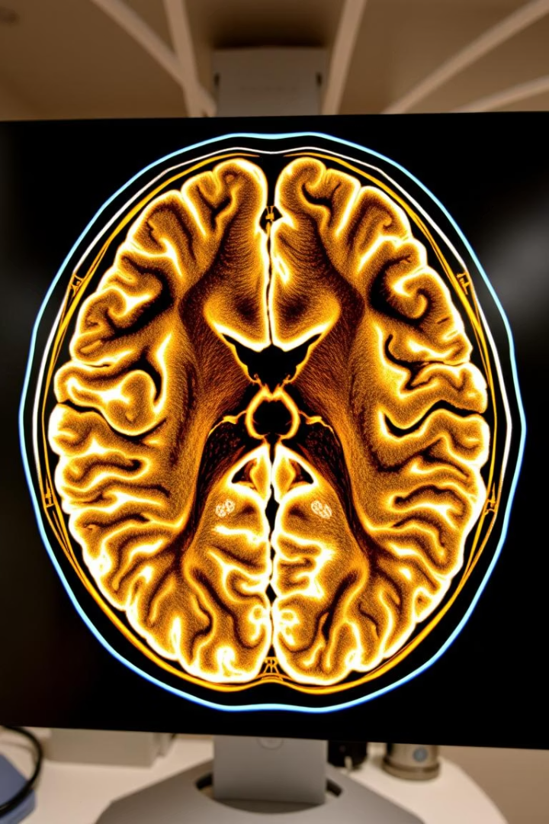
Design and Analysis of Algorithms (CS-251)
Image Segmentation in Medical Imaging
Semester Project
Group Members:
Jannat Shaheer
Zoiba Tabassum
Hassan Iftikhar
Muhammad Talha
Tanveer Haider
Course: BESE 29-B

Slide 2
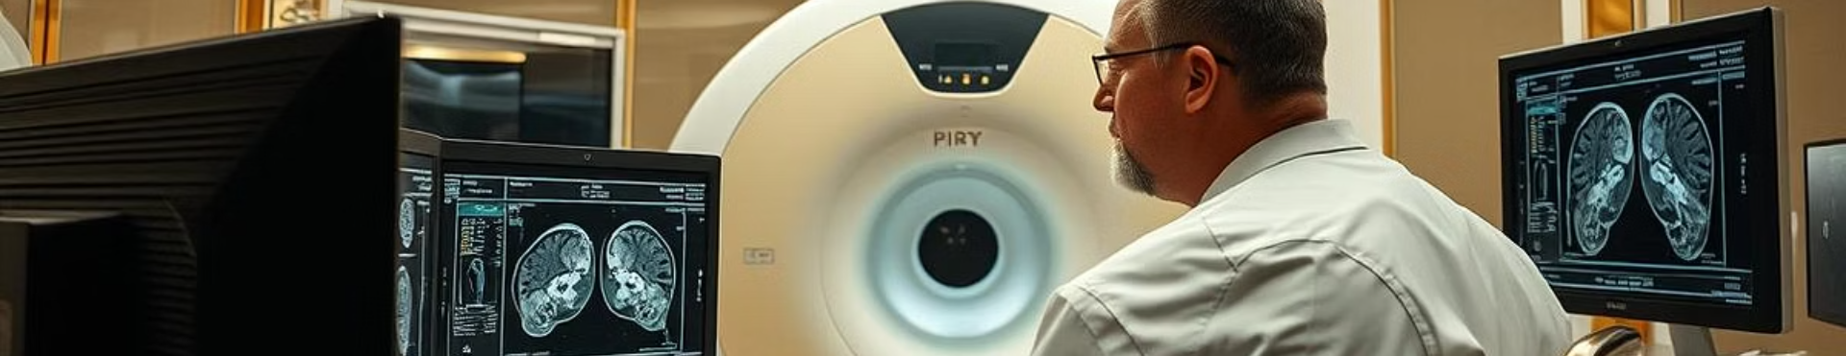
Project Overview
Problem Statement
Objectives
Significance
Develop an efficient algorithm to automatically segment tumor regions from MRI scans with high accuracy, differentiating tumor tissue from healthy regions.
Use Gaussian blur for noise reduction, K-Means clustering for pixel grouping, and morphological operations to refine segmentation masks, enabling reliable tumor detection.
The method supports diagnostics by automating time-consuming manual segmentation, improving consistency and feasibility in limited-resource settings.

Slide 3
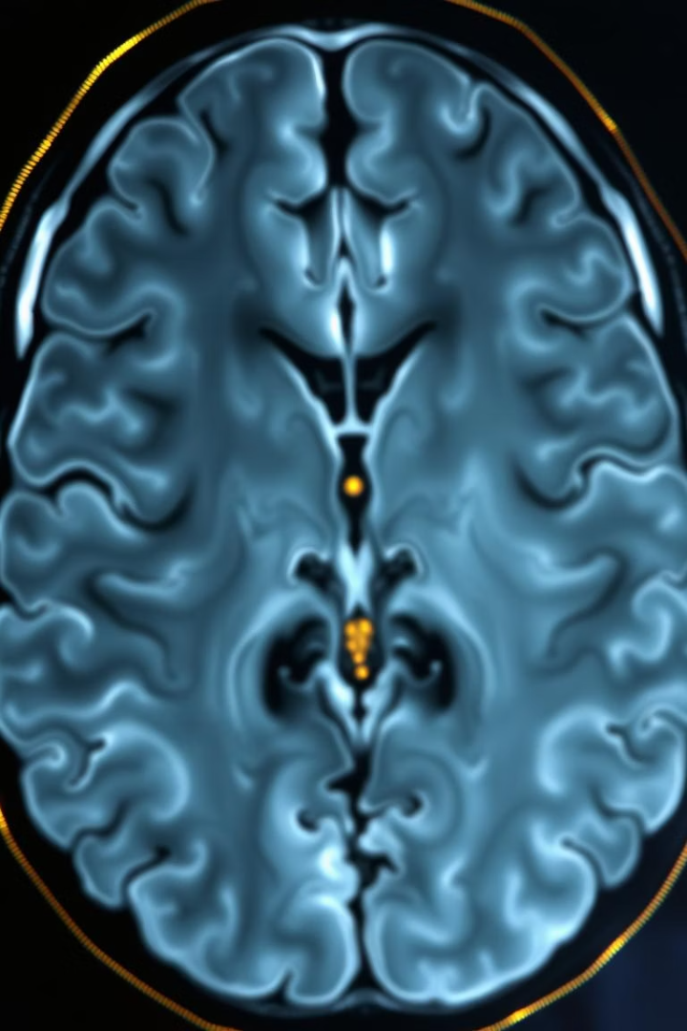


Methodology: Data Preprocessing and Image Flattening
Step 1: Data Preprocessing
Apply Gaussian blur to reduce noise and normalize pixel intensities by scaling values. Time complexity: O(n²k²), space complexity: O(n²).
Step 2: Image Flattening
Convert the 2D MRI image into a 1D pixel vector, preparing data for clustering algorithms. Time and space complexity: O(n²).

Slide 4

Methodology: Tumor Identification with K-Means Clustering
Step 3: Clustering and Detection
Clustering Process
Tumor Detection
Complexity
Group pixels into k clusters based on intensity similarity, assigning each pixel to the nearest centroid.
Identify the tumor as the cluster with the highest intensity values, isolating abnormal tissue regions.
Time complexity is O(n²ki), space complexity O(n² + k), where n is image dimension, k is clusters, and i is iterations.

Slide 5
Methodology: Binary Mask Generation and Noise Removal
Step 4: Binary Mask Generation
Step 5: Noise Removal
Convert clustered pixels into a binary mask where tumor pixels are foreground (1) and others background (0). Time and space complexity: O(n²).
Apply morphological closing (dilation followed by erosion) to remove small holes and noise, improving tumor region connectivity and shape. Time complexity is O(n²k²). and space complexity is O(n²).

Slide 6
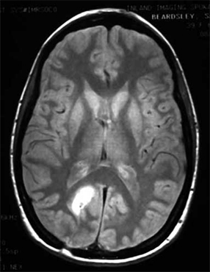
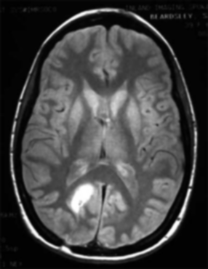
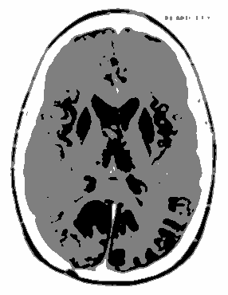


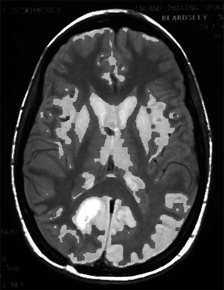
Visual Output of Each Algorithm Stage
Initial MRI
Gaussian Blur and Normalization
K-Means Clustering
Binary Mask Generation
Morphological Closing
Final Image after Overlay

Slide 7
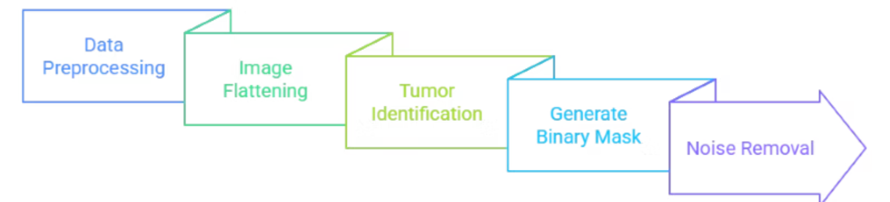
Big-O Notation Summary of Algorithm Steps
Step
Algorithm
Time Complexity
Space Complexity
1
Gaussian Blur
O(n²k²)
O(n²)
2
Array Traversal
O(n²)
O(n²)
3
K-Means Clustering
O(n²ki)
O(n² + k)
4
Thresholding
O(n²)
O(n²)
5
Dilation and Erosion
O(n²k²)
O(n²)

Slide 8

Conclusion:
Efficient and Scalable Tumor Segmentation
Proposed algorithm combines Gaussian blur, K-Means clustering, and morphological closing.
Achieves efficient and interpretable tumor segmentation.
Reduces noise, accurately segments tumor tissue, and refines the mask for better shape and connectivity.
Scalable and suitable for deployment in environments with limited computational resources, providing reliable support for medical diagnostics.

Slide 9

Future Enhancements and Directions
Adaptive Thresholding
Advanced Clustering
Integrate Otsu’s Method for improved tumor detection with adaptive thresholding.
Replace K-Means with DBSCAN or Mean Shift to better handle non-spherical tumor shapes.
3D MRI Extension
Hybrid Models
Extend the algorithm to segment tumors across 3D MRI volumes for comprehensive analysis.
Combine classical techniques with deep learning for enhanced segmentation accuracy and real-time deployment with GPU acceleration.

